Slide 1
GO Team Meeting
Toomer ES
May 8, 2023

Slide 2
Agenda
Call to Order
Roll Call; Establish Quorum
Action Items Approval of Agenda
  Approval of Previous Minutes:
Discussion Items
2023 Spring MAPS results
  Needs Assessment
Information Items
Principal’s Report
    2022-2023 Family Engagement and/or Partnership Highlights
  GO Team Elections
Announcements
Public Comment
Adjournment

Slide 3

2023 Spring
MAPS Results
Data Points to Consider
Spring Results
Fall to Spring Comparison
  Literacy
  Numeracy

Slide 4
Purpose for Reviewing Data
Guiding Questions
What does this data tell us?
What good news is there to celebrate?
Where are growth opportunities?
What trends do we see in the data?

Slide 5
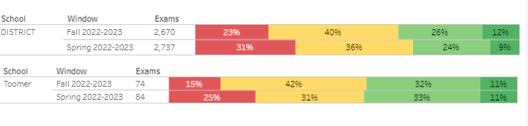
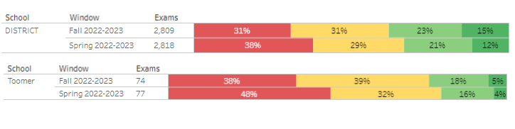
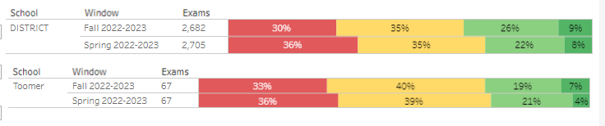
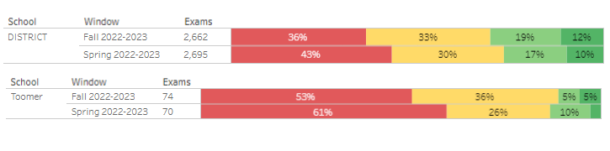
Math
Fall 2022-23
Spring 2023

Slide 6
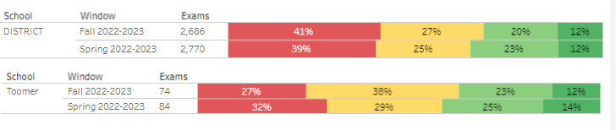
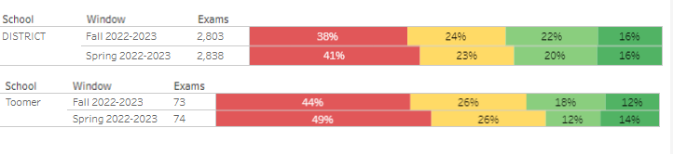
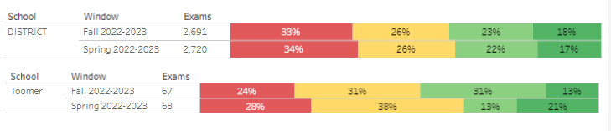
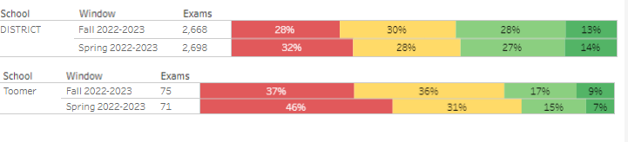
Reading
Fall 2022-23
Spring 2023

Slide 7

Needs Assessment
Needs Assessment
During this Needs Assessment, we will look at data from the Spring MAPS administration and identify 2-3 potential needs for the 2023-2024 school year.
This discussion will help school leadership as they begin developing the school’s 2023-2024 Continuous Improvement Plan this summer.
ACTIVITY

Slide 8
Needs Assessment:
Guiding Questions
What does this data tell us?
What good news is there to celebrate?
Where are growth opportunities?
What trends do we see in the data?

Slide 9
Needs Assessment:
What are two to three (2-3) needs we can identify based our data?
 | Need
1
2
3

Slide 10
Information Items

Slide 11

Principal’s Report

Slide 13

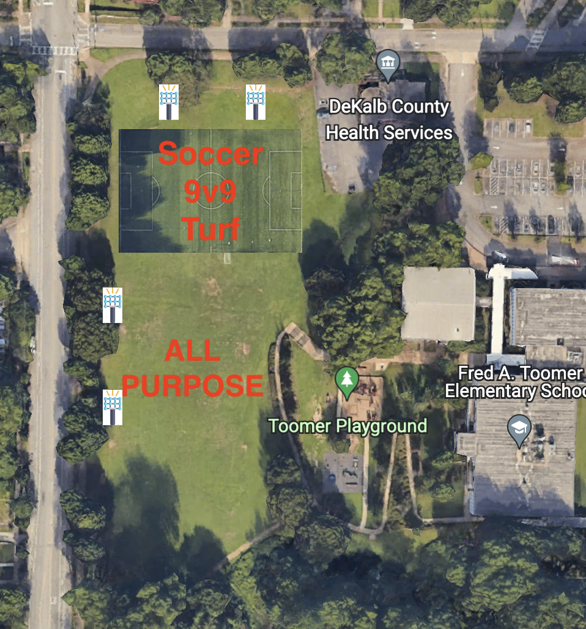


PROPOSED FIELD IMPROVEMENT SCOPE
TOOMER ELEMENTARY
Improvements
Re-grading and leveling of the playing surface
Top soil
Sports lighting
10 ft fencing all around
Improved porta-potties
*Possible turf of the SW corner in the future if feasible of

Slide 14
Additional Information Items
Cluster Advisory Team Report
GO Team Elections
  Find candidates at apsstrongschools.com
  Vote APRIL 18-27
  Households are sent a unique link based upon information in Infinite Campus
  School Staff will be sent a link to their APS email address

Slide 15

Announcements
GO Team Members
  Check your email starting May 1 for end of year survey links
    GO Team Satisfaction Survey
    Principal Feedback Survey
  Complete your required trainings ASAP
    Contact the GO Team Office with any questions

Slide 16


